Slide 1
Local Offer & FISH – Tutor Guide
Helping you support students to find information independently

Slide 2
Why this matters
Students often need quick access to support
Finding information on their own promotes independence
It supports their wellbeing and decision-making

Slide 3
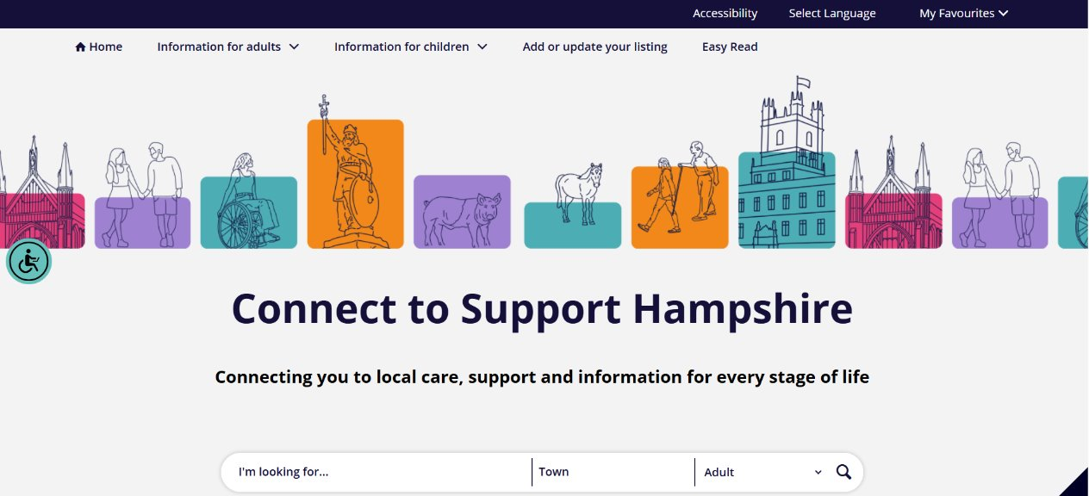
Home | Hampshire CTSH

Slide 4

What is the Local Offer?
The Local Offer is Hampshire website for SEND information for parents, carers and young people with SEND
It covers the types of education settings available, how they support children with SEN, and what to consider when deciding what might work best for your child.
Support for families with SEND, including breaks from caring
Health services, equipment and specific therapies for children and young people with SEND
Preparation for Adulthood, including further education options, employment options and building independence into adulthood
Organisations and activities that support the Hampshire Gateway Card scheme
A neurodiversity hub with a huge range of information to help parents support their child who they believe may have a neurodiversity

Slide 5
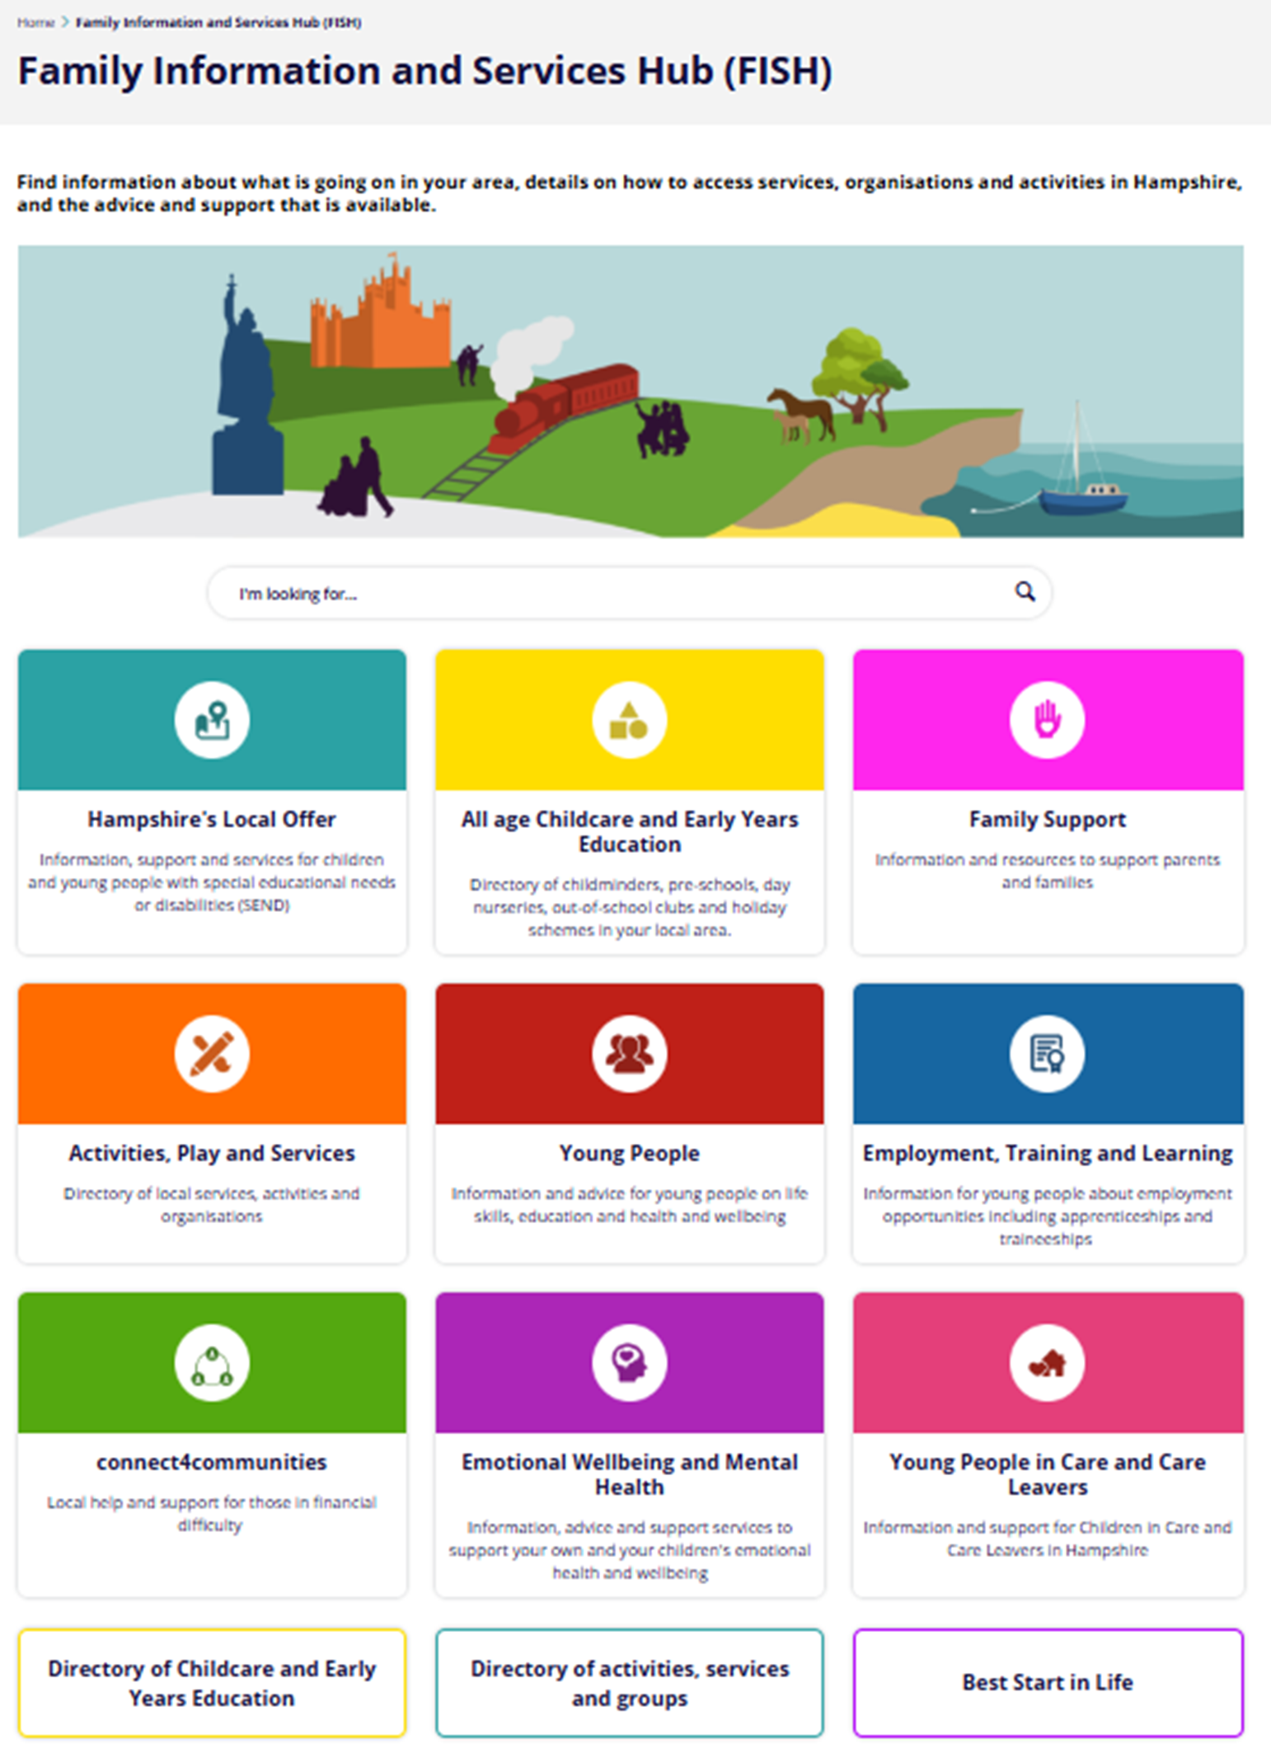
What is the Family Information and Services Hub?
Information and resources to support parents and families, including friendly, non-judgemental advice and information around a variety of topics.
Directory of local services, activities and organisations
Directory of childminders, pre-schools, day nurseries, out-of-school clubs and holiday schemes in your local area.
Information and advice for young people on life skills, education and health and wellbeing
Information for young people about employment opportunities including apprenticeships and traineeships
Local help and support for those in financial difficulty
Information, advice and support services to support adults and children's emotional health and wellbeing
Advice and support for young people in care and care leavers

Slide 6
Why promote the site it in school
Helps students solve their own problems
Builds life skills
Helps take some of the burden off pastoral teams
More awareness of the website means healthier, happier and better informed families

Slide 7
What students can find
Mental health support
Support to make informed decisions about post 16
Information about jobs and training
Financial help
Activities and services that they can reach out to if they need help

Slide 8
How to use in tutor time
Run as a short activity
Students work in pairs
Use phones/laptops
Explore the site

Slide 9
Suggested activity
Use the 'Can You Find It?' quiz
01
Encourage exploration
02
Discuss findings
03

Slide 10
Key message for students
You don’t have to wait for help
You can find answers yourself
Support is always available

Slide 11
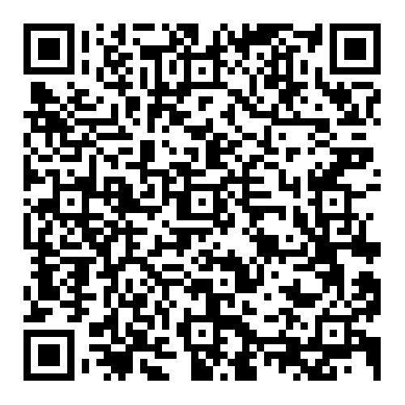
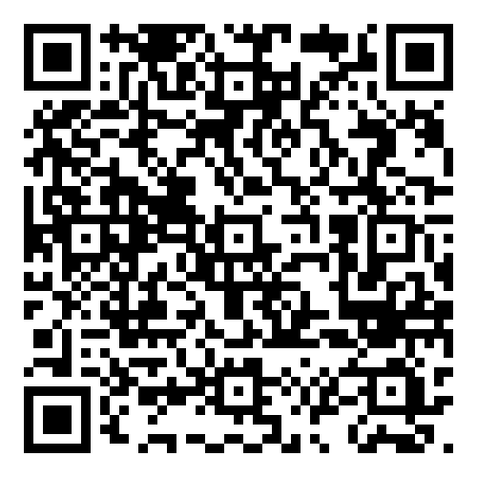
Access the sites
Local Offer:
https://www.connecttosupporthampshire.org.uk/family-information-and-services-hub-fish/send-local-offer/
FISH:
https://www.connecttosupporthampshire.org.uk/family-information-and-services-hub-fish/

Slide 12
Support available
Contact Local Offer team (localoffer@hants.gov.uk)
Request school information sessions and attendance at school events
adele.dodd@hants.gov.uk

Slide 13
Thank you
Supporting young people to access information independently

